Slide 1
Abstraction Encapsulation Abstract class Abstract method
Sarower Ahmmed

Slide 2
Method in JAVA
Concreate method- contains
Method name /signature
Method description or body
Abstract method-
Abstract method – only method name/signature but
No body or description inside
If a class contain a abstract method than class convert automatically abstract class

Slide 3
Other types of methods
Discussed earlier
Methods rules also discussed earlier
Main method also covered

Slide 4
Class in JAVA
Concreate class/ Normal class- contains
Complete method (Method signature/name + method body/description)- mean non-abstract method
No abstract word before class
Instantiation possible- we can create object from this class
Not must needed inheritance

Slide 5
Class in JAVA
2. Abstract class-
Abstract method – only method name/signature no body or description inside
Also contain abstract method
Abstract word before class
Not possible Instantiation - we can not create object from this class
Must inheritance and complete the class by completing the method description

Slide 6
What the meaning in English ?
An abstract or general idea or term apart from specific objects, or actual instances and not realistic.
Definition of abstraction - the quality of dealing with ideas rather than events,

Slide 7
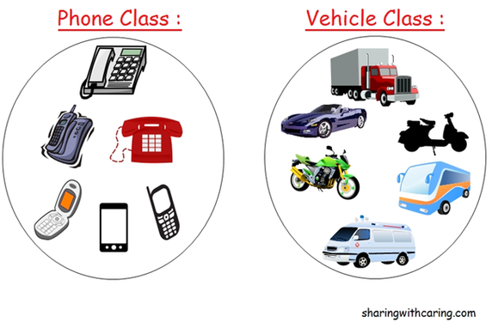

Slide 8
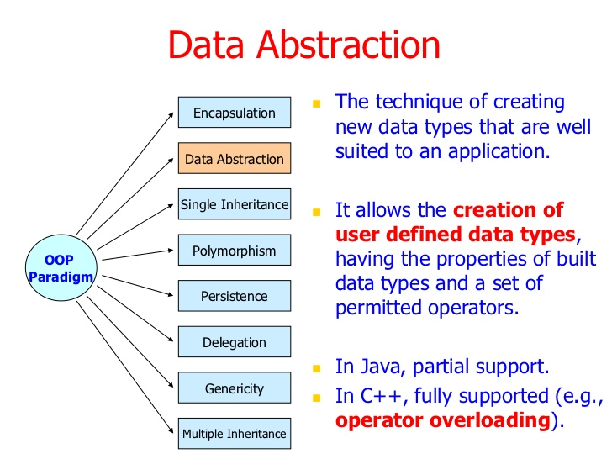

Slide 9


Slide 10
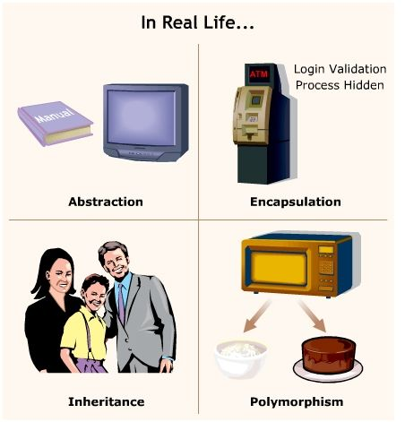

Slide 11
Polymorphism in java
The word ‘polymorphism’ literally means ‘a state of having many shapes’ or ‘the capacity to take on different forms’.
Poly means many
Morphism means form or structure
Where to use different form/ polymorphism in java –
Methods
constructor

Slide 12
Polymorphism in Java has two types
Method overloading or Compile time polymorphism (static binding) and
method overriding or Runtime polymorphism (dynamic binding).
Overloading
One class,
Same method name
But parameter diff
Overriding
Two class
Inheritance>> extends
Same method name
But same parameter or diff parameter

Slide 13

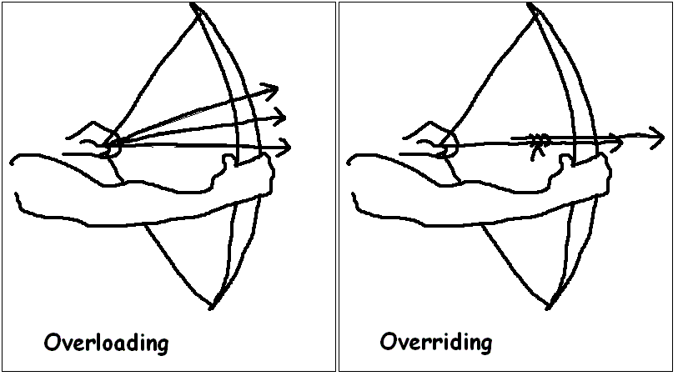


Overloading vs Overriding

Slide 14
Overloading or Compile time - criteria's
Overloading criteria or Compile time
Inside one class only
Same method or constructor name/signature
But only parameter change
Static and non static both method can use this
Only one Class, so no need inheritance of class

Slide 15
Example of method overloading polymorphism
class Calculation {
void sum(int a){
System.out.println(a);
}
void sum(int a,int b){
System.out.println(a+b);
}
void sum(int a,int b,int c){
System.out.println(a+b+c);
}
public static void main(String args[]) {
Calculation obj=new Calculation();
obj.sum(5); //5
obj.sum(20,20); //40
obj.sum(10,10,10); // 30
}
}
In such scenario, compiler is able to figure out the method call at compile-time that’s the reason it is known as compile time polymorphism.

Slide 16
Dynamic Polymorphism or runtime polymorphism or Overriding:
Criteria in java
Need two class (Child class extands parent class)
Use parent class same method name / signature in child class
But method parameter will be change
Static method no need overriding to use parent class method or overridding not possible
Constructor can not do overriding

Slide 17
How to do Overriding polymorphism
Suppose a sub class overrides a particular method of the super class.
Let’s say, in the program we create an object of the subclass and assign it to the super class reference.
Now, if we call the overridden method on the super class reference then the sub class version of the method will be called.

Slide 18
Overriding
}
}
class Vehicle{
public void move(){
System.out.println(“Vehicles can move!!”);
}
}
class MotorBike extends Vehicle{
public void move(){
System.out.println(“MotorBike can move and accelerate too!!”);
}
}
class TestDemo{
public static void main(String[] args){
Vehicle vh=new MotorBike();
vh.move();
}
}

Slide 19
Casting
Object create rule in java
Animal obj = new Animal();
Up casting - WebDriver driver = new ChromeDriver();
Down casting – Animal obj= new Dog();
Type casting - TakesScreenshot ts =(TakesScreenshot)driver;

Slide 20
Usage of Java Method Overriding
Method overriding is used to provide specific implementation of a method that is already provided by its super class.
Method overriding is used for runtime polymorphism

Slide 21
Rules for Java Method Overriding
method must have same name as in the parent class
method must have same or diff parameter as in the parent class.
must be IS-A relationship (inheritance).

Slide 22
Can we override static method?
No, static method cannot be overridden. It can be proved by runtime polymorphism, so we will learn it later.
Why we cannot override static method?
because static method is bound with class whereas instance method is bound with object. Static belongs to class area and instance belongs to heap area.

Slide 23
Can we override java main method?
No, because main is a static method.

Slide 24
Method Overloading | Method Overriding
Method overloading is used to increase the readability of the program. | Method overriding is used to provide the specific implementation of the method that is already provided by its super class.
Method overloading is performed within class. | Method overriding occurs in two classes that have IS-A (inheritance) relationship.
In case of method overloading, parameter must be different. | In case of method overriding, parameter must be same.
Method overloading is the example of compile time polymorphism. | Method overriding is the example of run time polymorphism.
In java, method overloading can't be performed by changing return type of the method only. Return type can be same or different in method overloading. But you must have to change the parameter. | Return type must be same or covariant in method overriding.

Slide 25
Java access modifiers with method overriding
If you are overriding any method, overridden method (i.e. declared in subclass) must not be more restrictive.
The default modifier is more restrictive than protected. That is why there is compile time error.
class A{
protected void msg(){System.out.println("Hello java");}
}
public class Simple extends A{
void msg(){System.out.println("Hello java");}//C.T.Error
public static void main(String args[]){
Simple obj=new Simple();
obj.msg();
}
}

Slide 26
Real example of Java Method Overriding
Consider a scenario, Bank is a class that provides functionality to get rate of interest. But, rate of interest varies according to banks. For example, SBI, ICICI and AXIS banks could provide 8%, 7% and 9% rate of interest.
Java method overriding example of bank

Slide 27
CHEASE
BANKOFAMERICA
CITY BANK

Slide 28
public class FEDRALBANK{
public int getRateOfInterest(int a){
return a;
}}
public class CHEASEBANK extends FEDRALBANK{
public int getRateOfInterest(int a){
System.out.println("CHEASEBANK Interest is ::"+a);
return a;
}}
public class BankOfAmerica {
public int getRateOfInterest(int a){
System.out.println("BankOfAmerica Interest is ::"+a);
return a;
}}

Slide 29
public class Test {
public static void main(String[] args) {
CHEASEBANK obj=new CHEASEBANK();
obj.getRateOfInterest(5);
BankOfAmerica obj1=new BankOfAmerica();
obj1.getRateOfInterest(7);
}
}Test it Now
Output:
SBI Rate of Interest: 8
ICICI Rate of Interest: 7
AXIS Rate of Interest: 9

Slide 30
Overriding
}
}
class Vehicle{
public void move(){
System.out.println(“Vehicles can move!!”);
}
}
class MotorBike extends Vehicle{
public void move(){
System.out.println(“MotorBike can move and accelerate too!!”);
}
}
class TestDemo{
public static void main(String[] args){
Vehicle vh=new MotorBike();
vh.move();
}
}

Slide 31
Why java need static method?
No need to create object to call this static method – from one class to another class.
Static methods are class level, so JVM call them with or after the class
Performance faster than non static method as
No need object creation to call this method
No need to overridden polymorphism
Poly morphism
Overloading – static and non static method
Overriding –only non static , not possible for static method

Slide 32
Constructor Overloading
If same Name constructor exists multiple times
in the same class with
different number of parameters or
order of parameters or
type of parameters
is known as Constructor overloading.
Why need- constructor overloading
can be used to initialize same or different objects with different values.

Slide 33
Same constructor name but parameter different- help to re use same code / constructor
class Demo {
Demo () {
Your code here
}
Demo (datatype1 value1) {
Your code here
}
Demo (datatype1 value1, datatype2 value2) {
Your code here
}
Demo (datatype2 variable2) {
Your code here
}
Demo (datatype2 value2, datatype1 value1) {
Your code here
}
Your code here
}

Slide 34
Why overriding is not possible at constructor level.
The scope of constructor is within the class
But overriding process happen outside of the class
So that it is not possible to achieved
No overriding at constructor level.

Slide 35

Abstraction in Java
Abstraction is a process of hiding the implementation details and showing only functionality to the user.

Slide 36


it shows only important things to the user and hides the internal details

Slide 37

Abstraction lets you focus on what the object does instead of how it does it

Slide 38


Slide 39
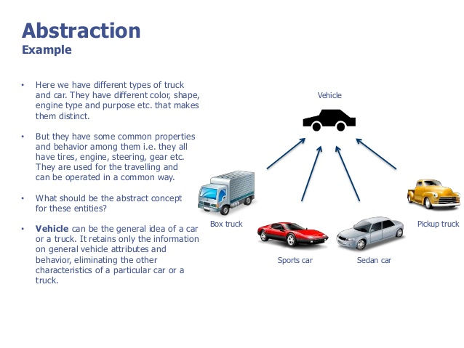

Slide 40
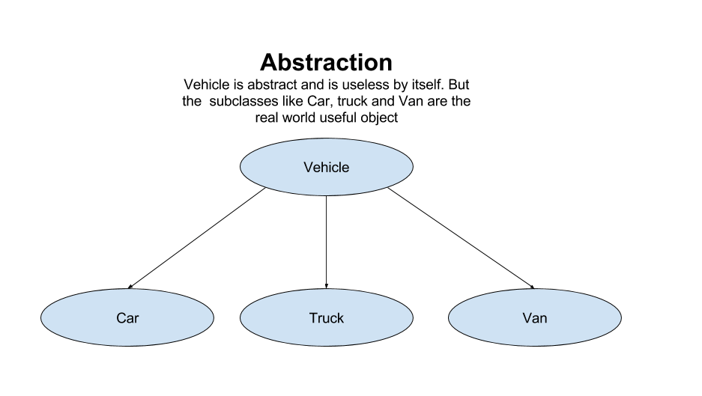

Slide 41
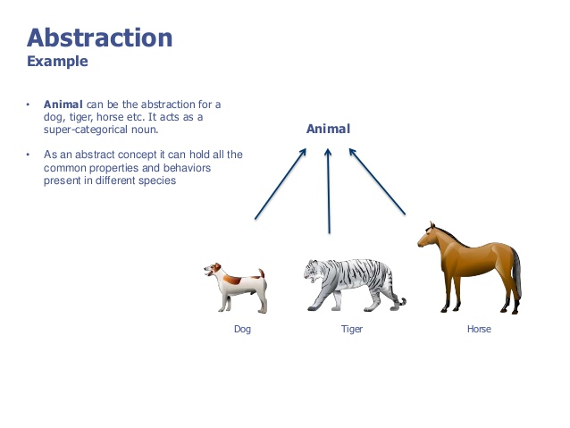

Slide 42
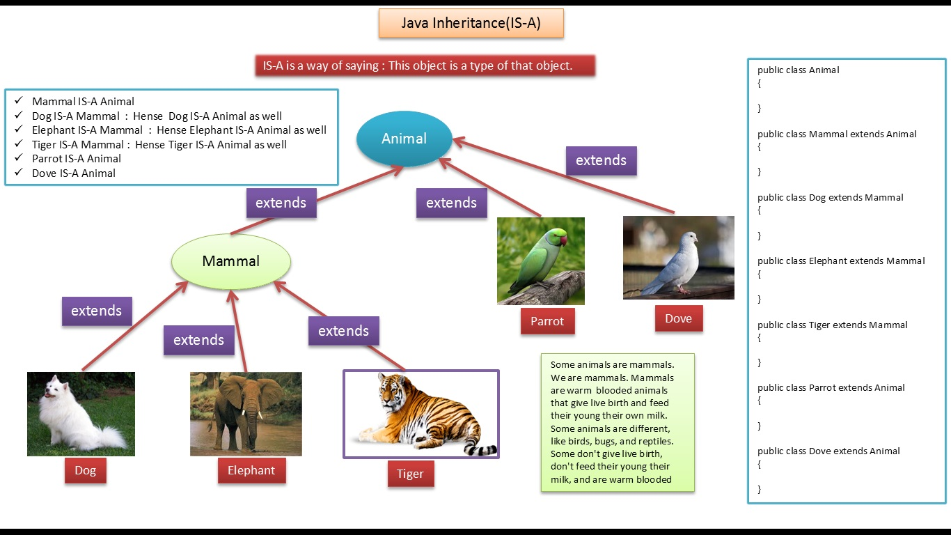

Slide 43
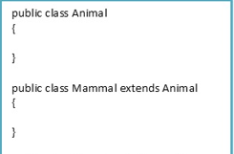
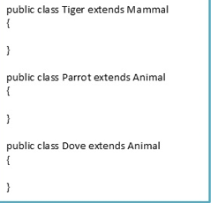
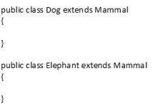

Slide 44
Why java need Abstraction ?
Hiding the implementation details and showing only functionality to the user.

Slide 45
Ways to achieve Abstraction in java
There are two ways to achieve abstraction in java
Abstract class (0 to 100%)
Interface (100%)

Slide 46
Rule of abstraction in java
Use abstract class (use abstract word before class name)
Abstract class contain abstract or non-abstract method
Use interface (contain incomplete or abstract method)
Must be inheritance(extends) –abstract class to other class and complete abstract class
Must be implement interface to another class to complete abstract method in side interface

Slide 47
Abstraction vs Inheritance
Points | Abstraction | Inheritance
Class | Abstract class | Concrete class
Method | Abstract or non-abstract method | non-abstract method
Create object / instantiation | Can not instantiation of same class(no object creation) | Possible
Why java need? | Hiding detailed implementation | Getting propertied from parent to child class
Dependency | If Abstract class or abstract method- must inherited and complete the class and methods | If we want to get parent properties to child than need inheritance
How to do in java | By Abstract class and interface | By using extends word

Slide 48
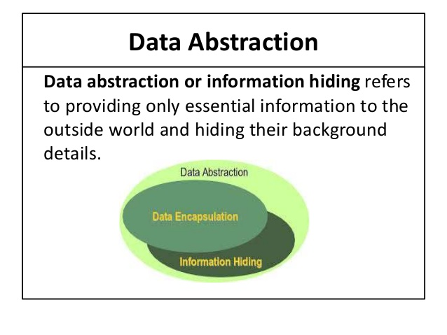

Slide 49
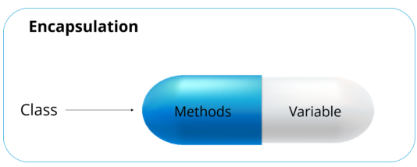
Encapsulation
Protect the code from outside world.

Slide 50

Abstraction lets you focus on what the object does instead of how does it work
Encapsulation hiding the code inside remote
And encapsulation

Slide 51
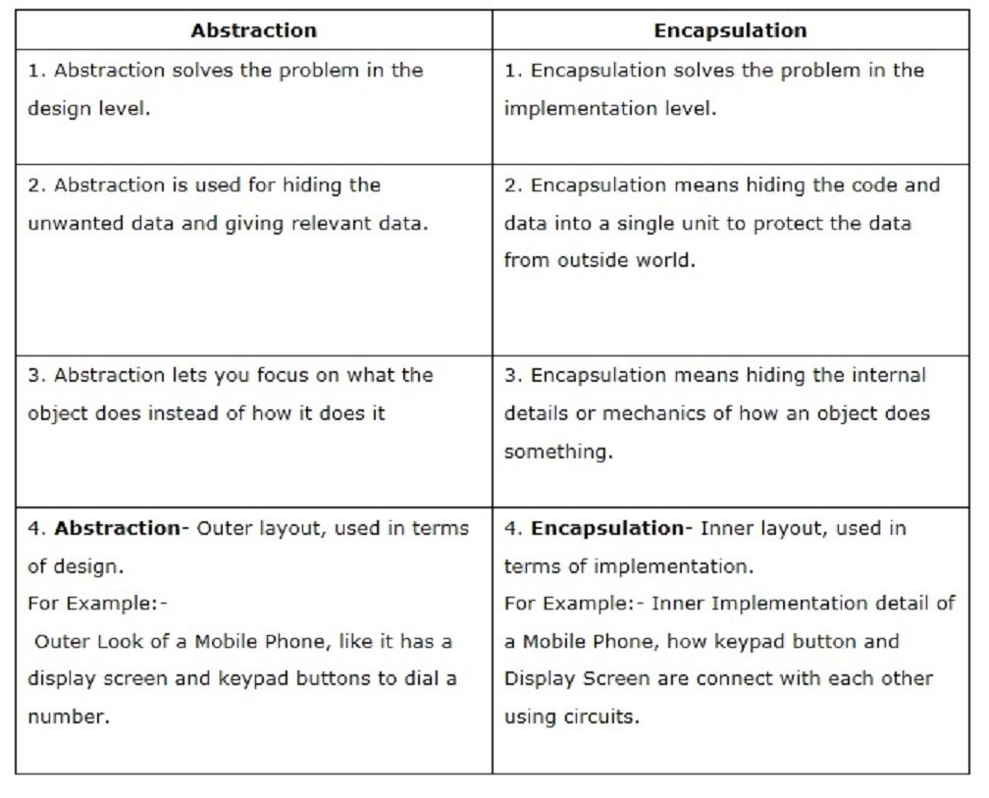

Slide 52
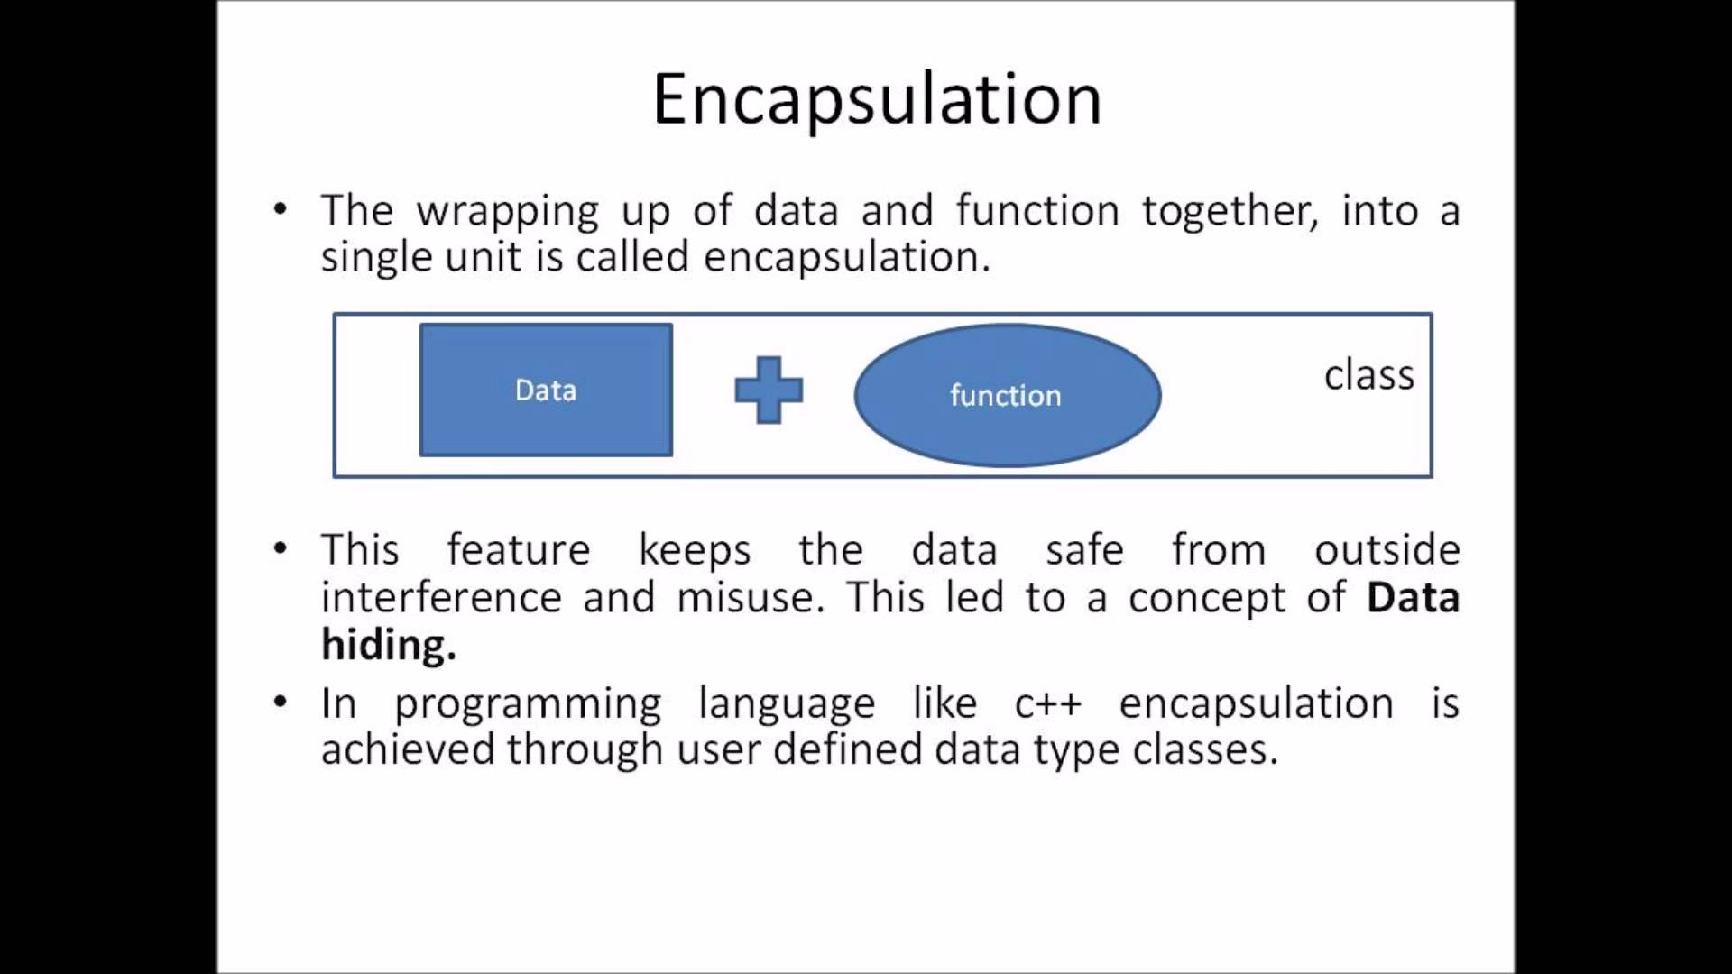

Slide 53
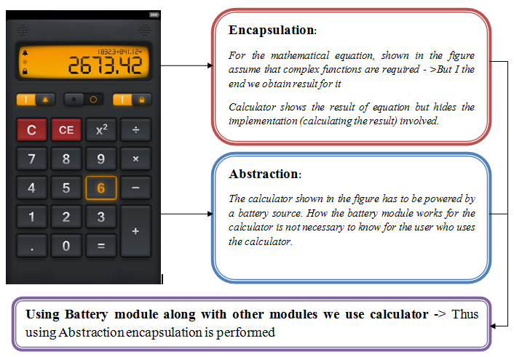

Slide 54
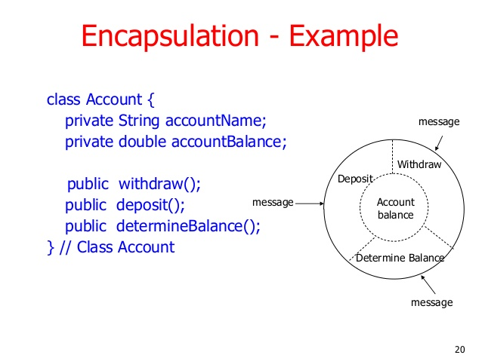

Slide 55
Rule of encapsulation
Variable must be private access modifier-No outside class can access private data member (variable) of other class.
Use public getter and setter methods to update -the private data fields/variable then the outside class can access those private data fields via public methods.
That’s why encapsulation is known as data hiding.

Slide 56
Inheritance
class Account {
// member declarations }
class SavingsAccount extends Account {
// inherit accessible members from Account // provide own member declarations }

Slide 57
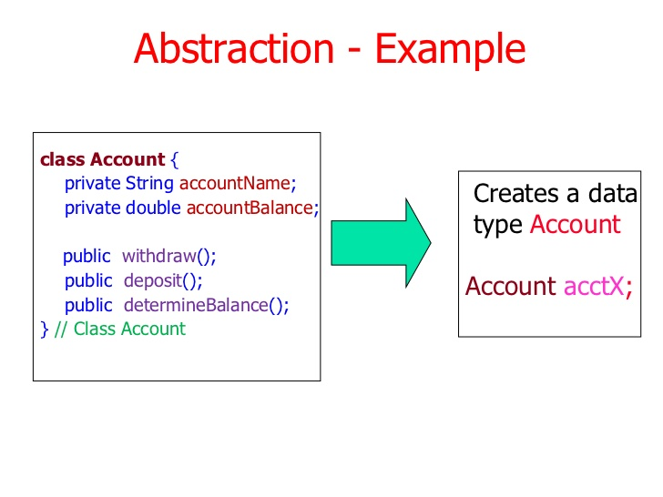
ENCAPSUALTION
CONSTRUCTOR

Slide 58
class Account {
private String name;
private long amount;
Account(String name, long amount) {
this.name = name;
setAmount(amount); }
void deposit(long amount) {
this.amount += amount;
}
String getName() {
return name;
}
long getAmount() {
return amount;
}
void setAmount(long amount) {
this.amount = amount; }
}

Slide 59
class SavingsAccount extends Account {
SavingsAccount(long amount) {
super(“saving", amount);
}
void withdraw(long amount) {
setAmount(getAmount() - amount);
}
}
class CheckingAccount extends Account {
CheckingAccount(long amount) {
super("checking", amount);
}
void withdraw(long amount) {
setAmount(getAmount() - amount);
}
}

Slide 60
class AccountDemo {
public static void main(String[] args) {
SavingsAccount sa = new SavingsAccount(10000);
System.out.println("account name: " + sa.getName());
System.out.println("initial amount: " + sa.getAmount()); sa.deposit(5000);
System.out.println("new amount after deposit: " + sa.getAmount());
CheckingAccount ca = new CheckingAccount(20000);
System.out.println("account name: " + ca.getName());
System.out.println("initial amount: " + ca.getAmount()); ca.deposit(6000);
System.out.println("new amount after deposit: " + ca.getAmount()); ca.withdraw(3000);
System.out.println("new amount after withdrawal: " + ca.getAmount()); } }

Slide 61
More code for Encapsulation
public int getEmpAge(){
return empAge;
}
public void setEmpAge(int newValue){
empAge = newValue;
}
public void setEmpName(String newValue){
empName = newValue;
}
public void setEmpSSN(int newValue){
ssn = newValue;
}
}
public class EncapsulationDemo{
private int ssn;
private String empName;
private int empAge;
//Getter and Setter methods
public int getEmpSSN(){
return ssn;
}
public String getEmpName(){
return empName;
}

Slide 62
Create another class and main method to run code
public class EncapsTesting{
public static void main(String args[]){
EncapsulationDemo obj = new EncapsulationDemo();
obj.setEmpName("Mario");
obj.setEmpAge(32);
obj.setEmpSSN(112233);
System.out.println("Employee Name: " + obj.getEmpName());

Slide 63
Advance Java topic

Slide 64
Final word in Java
Any thing final- cant be change later
Final class can not be inheritance to other class

Slide 65
Final classes
You might declare a class that should not be extended; for instance for security reasons.
In Java, we use the final keyword to prevent some classes from being extended.
Simply prefix a class header with final, as in final class Password.
Given this declaration, the compiler will report an error if someone attempts to extend Password.

Slide 66
final can be used to mark a variable "unchangeable"
private final String name = "foo"; //the reference name can never change
final can also make a method not "overrideable"
public final String toString() { return "NULL"; }
final can also make a class not "inheritable". i.e. the class can not be subclassed.
public final class finalClass {...}
public class classNotAllowed extends finalClass {...} // Not allowed

Slide 67
finally
finally is used in a try/catch statement to execute code "always"
lock.lock();
try {
//do stuff
} catch (SomeException se) {
//handle se
} finally {
lock.unlock(); //always executed, even if Exception or Error or se
}

Slide 68
finalize
finalize is called when an object is garbage collected. You rarely need to override it. An example:
protected void finalize() {
//free resources (e.g. unallocate memory)
super.finalize();
}

Slide 69
Thanks All

